Slide 1
Research Planning - Prediction of voting decisions of Proxy advisors toward election of directors based on Proxy reports guided by Policy Hongsang Yoo

Slide 2
1. Identification of research question (Terms)
Research Question:
Prediction of voting decisions of Proxy advisors toward election of directors
based on Proxy reports guided by Policy
Proxy advisors: Consulting firms that provide votes recommendation
e.g) ISS, Glass Lewis (top 2 companies in this field)
Policy: Guidelines of ‘’Proxy advisors”
e.g) • Vote against the nominee with attendance less than 75 % of the board meeting
• The board must be majority independent.
Proxy report: Documents uploaded by companies to reveal information to shareholders

Slide 3
1. Identification of research question (Illustration)
Research Question:
Prediction of voting decisions of Proxy advisors toward election of directors based on Proxy reports guided by Policy
Company (e.g. Samsung)
Holds annual shareholder meeting.
Wants to get shareholders’ approval for directors’ election
Vote according to the recommendation of Proxy Advisors
Upload Proxy Reports
WEB
Proxy Advisor
(e.g. Glass Leiws, ISS)
Vote recommendation based on Policy
Institutional shareholder
(e.g. JP morgan)
Individual shareholder (e.g. me)
Delegate voting rights

Slide 4
2. Prior Literature review
Existing researches: Sentiment extraction
- No sentiment polarity toward directors. Not suitable.
3 phases to implement the system:
1) Proxy reports - Building hierarchical representation
2) Policy - Ontology construction
3) Classification using Hierarchical Deep learning guided by ontology

Slide 5
3. MOTIVATION
Work experience both in ISS and Glass Lewis (Proxy advisors)
Can we automate analysis of agenda and vote recommendation that analysts do?
Problem
• Individual shareholders not familiar toward agenda, but their vote shares take up a large portion of the total
• Costs for hiring and training analysts of Proxy advisors
=> Automation of the process can solve this!

Slide 6
4. DATA
3 types of data: Proxy report, Policy, Label
 | What | Where | How
1 | Proxy reports data | https://englishdart.fss.or.kr/ | Web API
2 | Policy data | Glass Lewis, 2019 Proxy Paper Guidelines:Shareholder Initiatives | Published on the web
3 | Label (Recommendation of Proxy Advisors: For/Against) | http://www.cgs.or.kr/eng/main/main.jsp | Web Crawling software or code implementation

Slide 7
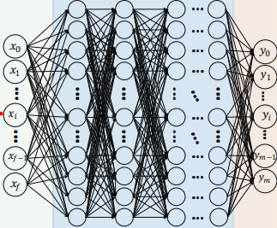
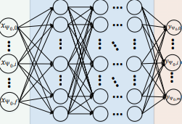
5. MEASURES
STEP 1:
Transform Proxy reports into hierarchical representation
Proxy Reports
Methods:
Computing PMI (Pointwise Mutual Information)
Hearst’s linguistic pattern
STEP 2:
Construct Ontology from Policy
Policy
Use the same method above
Input
Level1 DNN
Level2 DNN
Output
STEP 3:
2-Level Deep
Neural Network
Output
Input
Transformed
Proxy reports & Policy
Certain Director
Vote Against!
* Image modified from HDLTex:Hierar-chical Deep Learning for Text Classification.arXiv:1709.08267

Slide 8
6. Test
1) Baseline
- TF-IDF with Logistic regression.
: simple baselines without implementation of word embeddings,
• TF-IDF: Term Frequency and Inverse Document Frequency model.
often considered to be a good model for text classification.
2) Evaluation metrics
F1 score toward negative labels (negative: Vote against)
• F1 score: harmonic mean of the precision and recall
• Precision: number of correct positive results divided by the number of all positive results returned by the classifier
• Recall: number of correct positive results divided by the number of all relevant samples

Slide 9
7. Contribution
Research Question:
Prediction of voting decisions of Proxy advisors toward election of directors based on Proxy reports guided by Policy
1) Benefits of Individual shareholders
2) By automation of the process, save costs for Proxy Advisors
Company
(e.g. Samsung)
Vote on behalf of individual shareholder
Proxy Advisor
(e.g. ISS)
Vote recommendation
Institutional shareholder
(e.g. JP morgan)
Individual shareholder (e.g. Me)
Hmm.. I don’t know anything
Delegate voting rights

